Slide 1
Principles and Practices of quality management /improvement: tools, techniques and models

Slide 2

Learning objectives
At the end of the session, participants should be able to;
Explain quality management concept
State the purpose of quality management
Explain Principles of quality management
Recognize different approaches and models in quality management in health
Analyze advantages and disadvantages as well as applications of the model

Slide 3
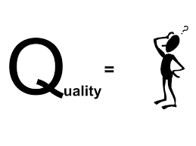
The totality of features and characteristics of a product or service that bears its ability to satisfy stated or implied needs - ISO 8402-1986 standard
Is a general term applicable to any trait or characteristic whether individual or generic – Merriam-Webster dictionary
Source: https://i.ytimg.com/vi/ZpFqnefTGA8/maxresdefault.jpg
Notes:
How good something is in comparison to similar items.
The extent to which it surpasses expectations
The totality of features and characteristics of a product or service that bears its ability to satisfy stated or implied needs - ISO 8402-1986 standard

Slide 4

Quality Management
Procedures to monitor, assess, and improve the quality of care
"explicitly designed"

Slide 5

Peer review Audits Quality Manual
Examples
Patient Satisfaction surveys
Complaints handling

Slide 6

Quality Improvement = Quality Management

Slide 7

Why quality management?
demonstrate a commitment to quality of care and services
Meet/exceed the needs and expectations of clients
Source: http://almabia.ae/commitment-to-quality/

Slide 8

Ensure leadership style that
guide, facilitate and involve implementers
pool personnel skills, talents and knowledge for quality

Slide 9
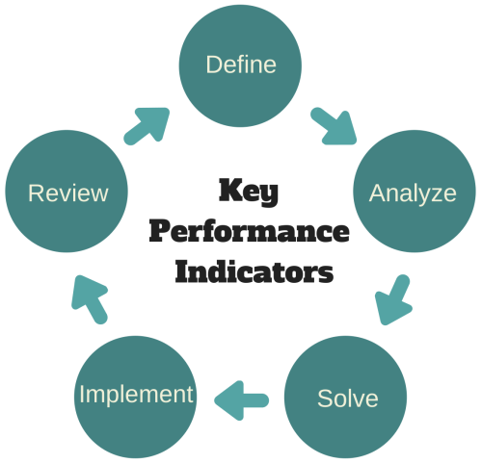
Why quality management? Cont..
Analyse and improve work processes
To measure system performance using PIs

Slide 10

Principles of quality management;
Strengthen systems and processes
Organisation = collection of systems and processes that depend on each other.
Know how problems can occur in each situation to strengthen the organisation

Slide 11
Principles of quality management;cont...
Encourage self-participation and teamwork
through empowerment every individual member of the team can participate in assuring good quality

Slide 12
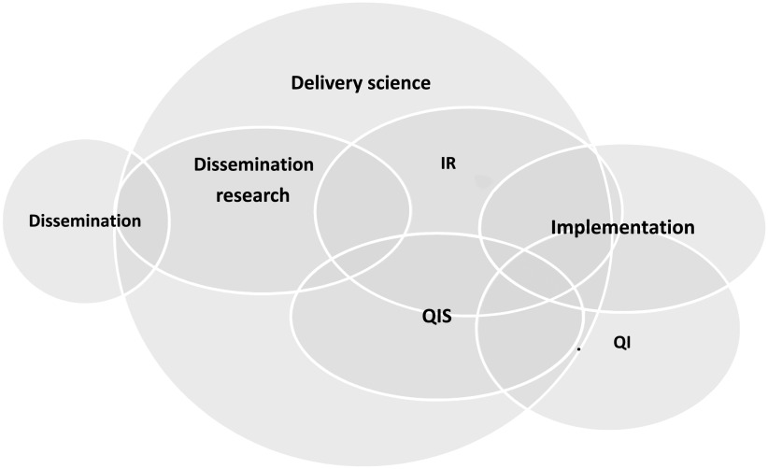
Example overlap of different domains of delivery science
Source: https://pmc.ncbi.nlm.nih.gov/articles/PMC8074111/

Slide 13
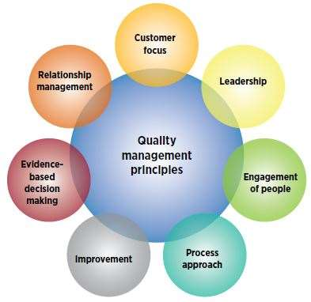
https://asq.org/-/media/Images/Learn-About-Quality/QMS-principles.JPG?h=382&w=393&la=en

Slide 14

Principles of quality management; cont
Use
Use reliable information (timely,accurate)
Improve
Improve communication and coordination
Commit on
Leaders: Commit on quality improvement
Notes:
Basing definition on reliable information: Using accurate and timely information manager can detect problems to take corrective measure.
Improving communication and coordination: Sharing information across different units facilitate quality improvement
Leadership quality: Commitment on quality improvement from the leaders will entice providers to take quality improvement as part and parcel of their work

Slide 15
Quality Management Concepts

Slide 16
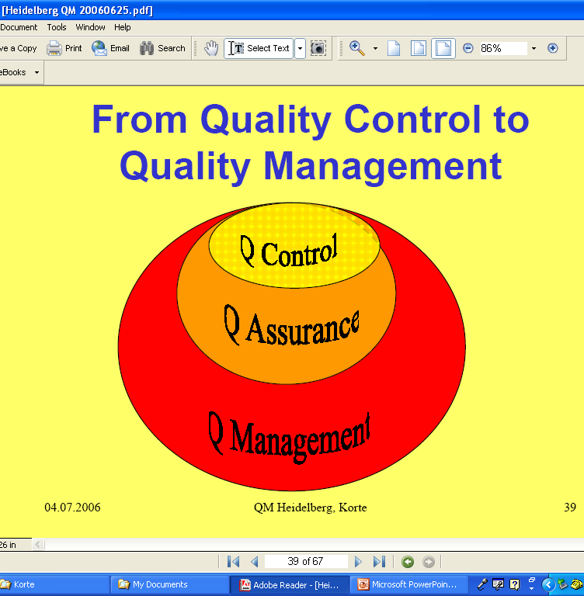
Quality Control Vs Quality Management

Slide 17

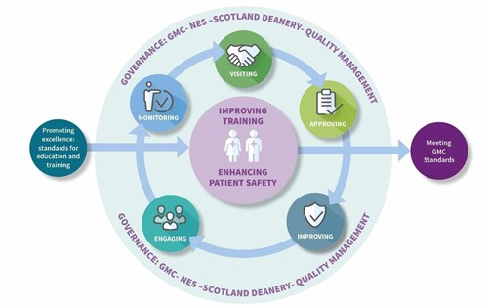
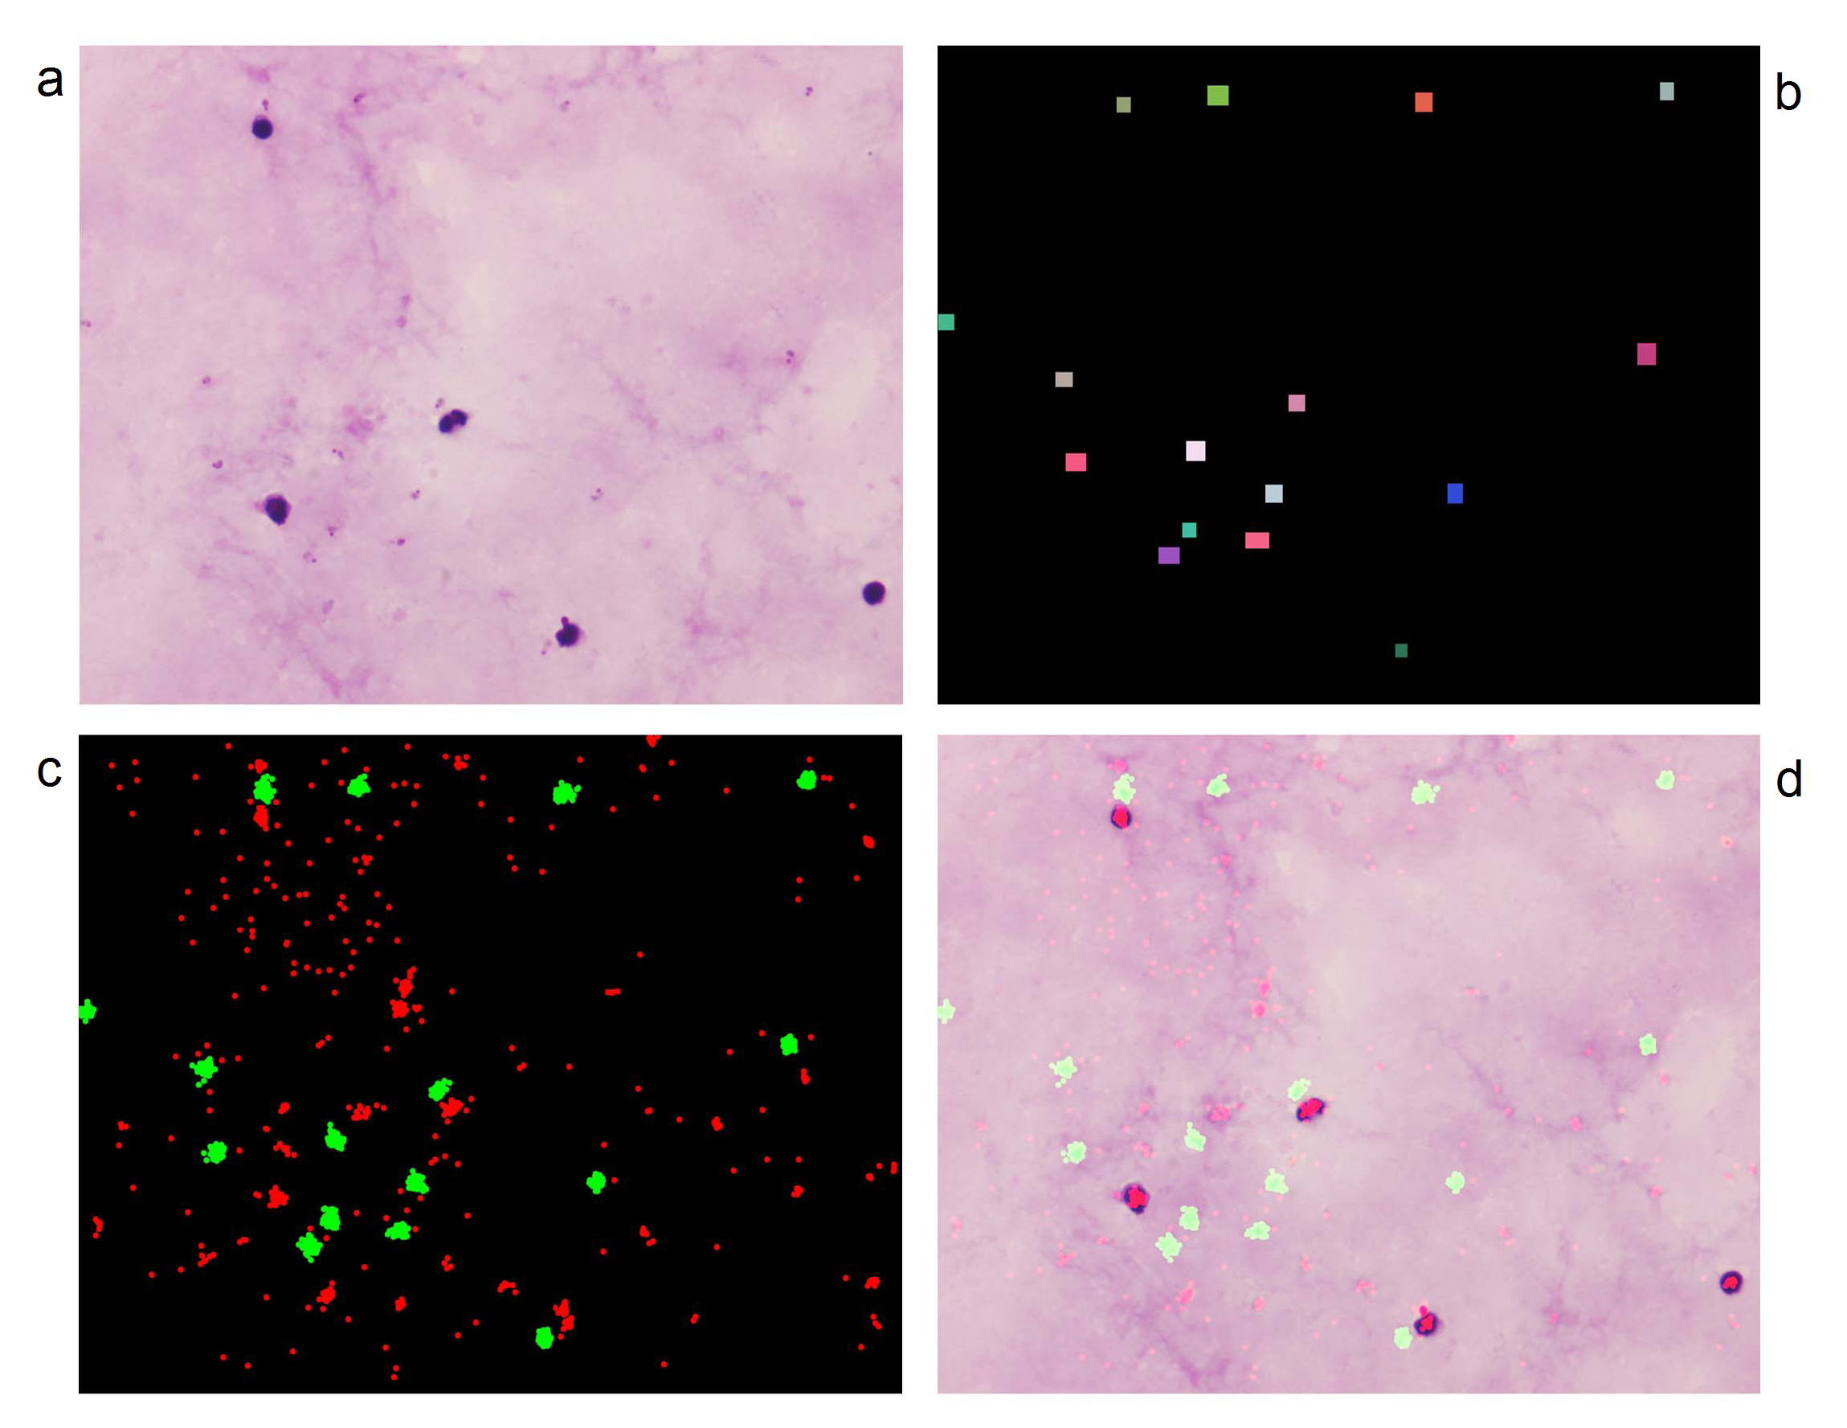
Control
Inspect and check finished products against standards eg. Lab setting
Faults detected at the end of the process (health care)
Management
set, maintain, monitor performance standards eg. Clinical governance –commit to QI (NHS initiative)

Slide 18
Quality Assurance (QA)
Quality assurance puts together and analyses the processes leading to a desired result.
assures compliance to specifications, requirements or standards and implementing methods for conformance”.

Slide 19


All the processes and sub-processes of
planning, setting objectives, standards, communicating, developing indicators, setting thresholds, collecting data to monitor compliance with standards and applying solutions to improve health care
The human face of quality (mistakes)

Slide 20
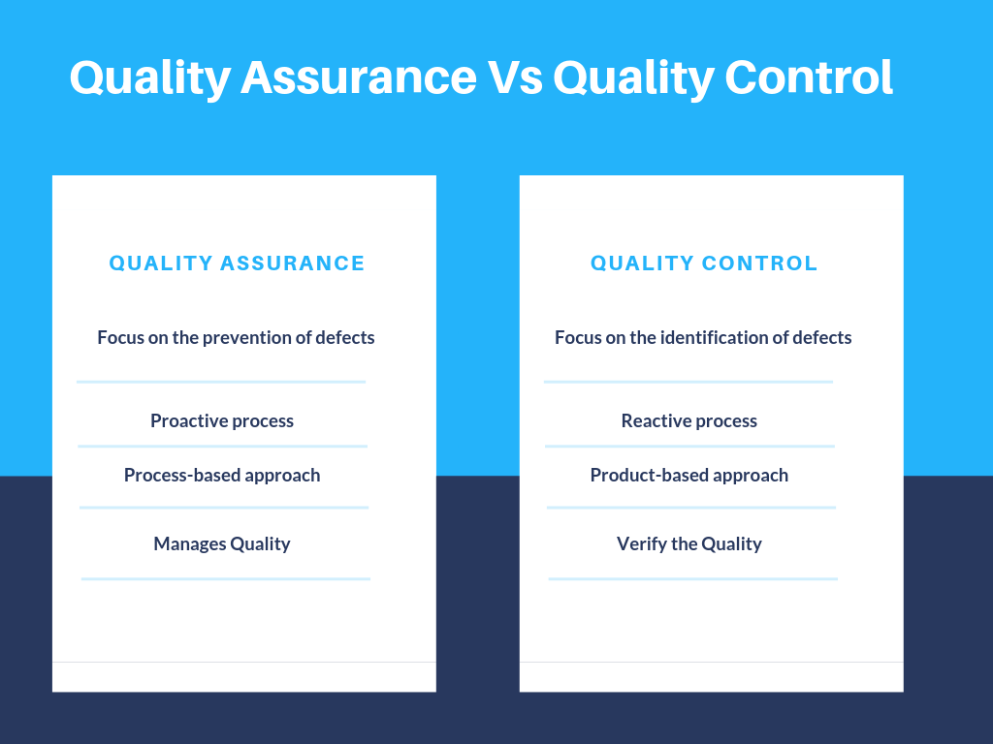

Slide 21
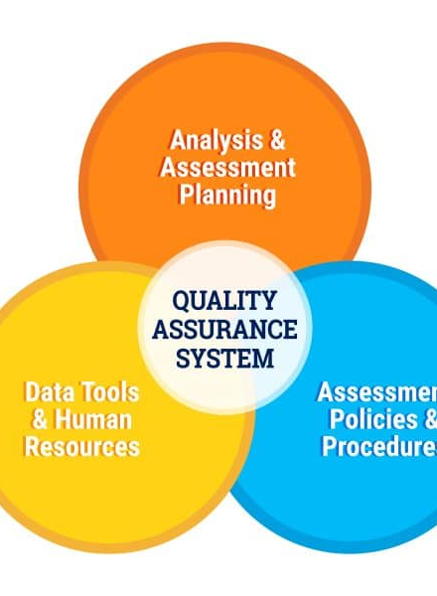
Tools and elements of QA
Efficient HMIS
Standards, guidelines, protocols, SOPs
Inspection, supervision, auditing
Indicators and milestones to measure performance

Slide 22
Quality Management Models/frameworks

Slide 23
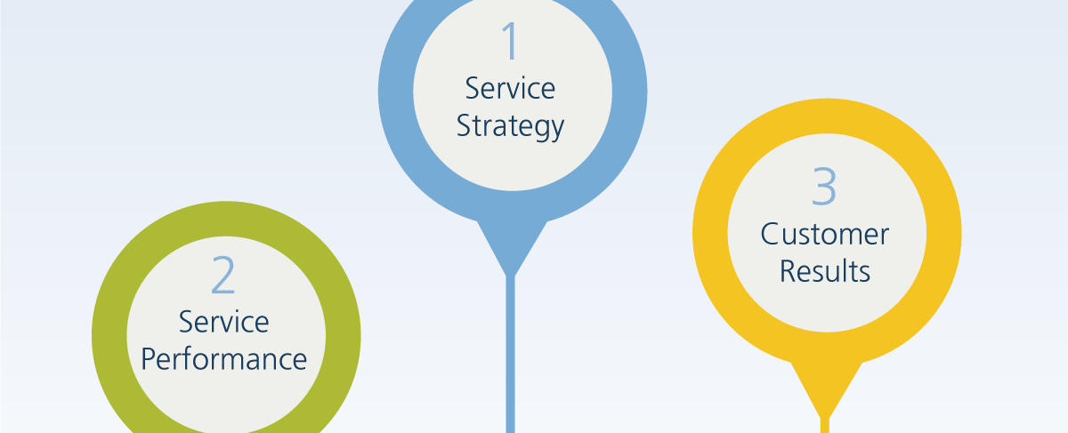
What are the models for?
Help organisations to consider all aspects
self-assessment guides/guides for auditing or accreditation
Notes:
The key to successful quality improvement may not be the choice of the method but how and by whom it is applied
Each model has a unique feature. Importance should not be based on the model rather on the features that are potentially useful at the district level.
Models are used to help an organisation for example a hospital to look at all aspects of its performance and quality of services.
Models can be used as self-assessment guides or as guides for auditing or accreditation.

Slide 24
What are the models for?
Each model has a unique feature
look at features
success not on the choice of the model
but
how and by whom it is applied

Slide 25
Quality models in car manufacturing industry
Video - 3min

Slide 26

Health service models or frameworks as a prerequisite for assessment
how are the relevant parts of the health system function and interact.
link service components, interactions, stakeholders (e.g. service users and providers) and factors influencing their interaction

Slide 27
Health service models or frameworks as a prerequisite for assessment
Simplification of the real situation for the sake of being operational
Aims at understanding the process of interest (in our case health seeking and service delivery) and finally to predict effects of interventions

Slide 28
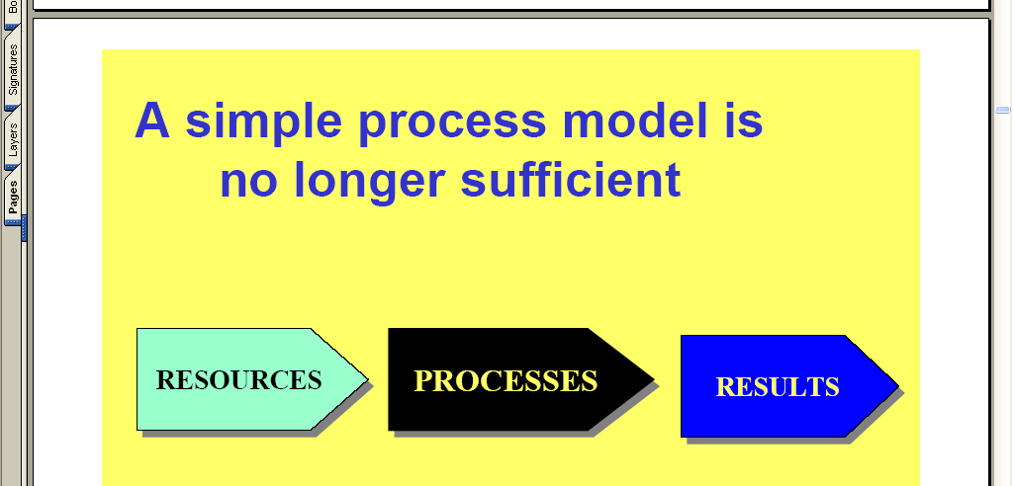
Models

Slide 29
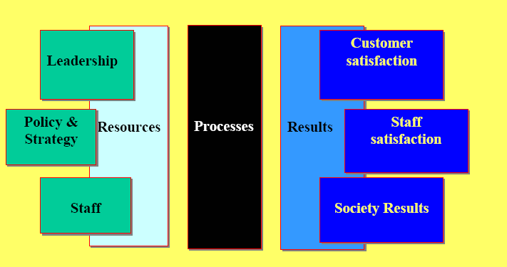
A Comprehensive Approach to Quality Management is Needed

Slide 30
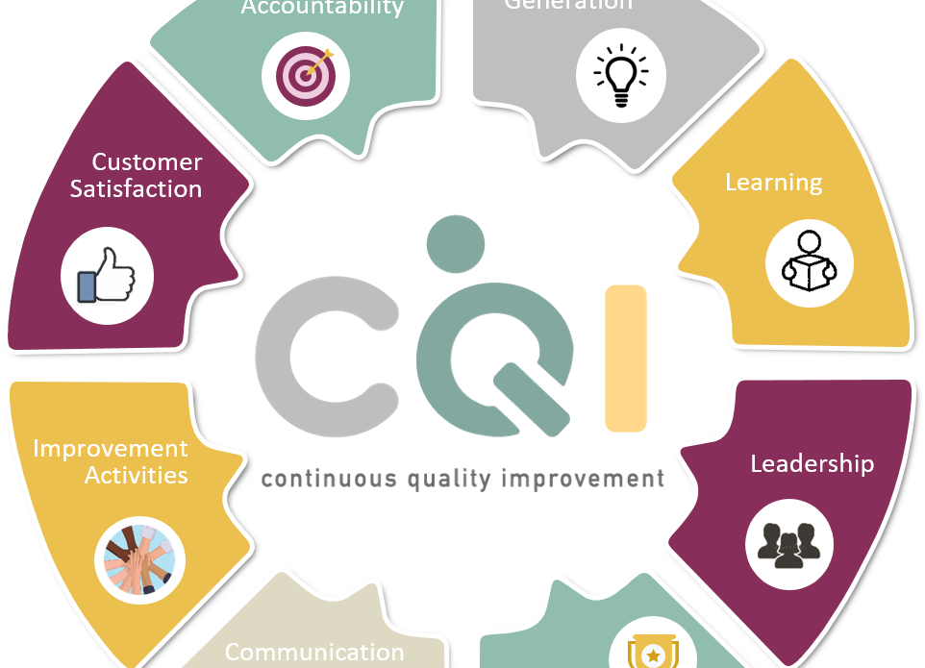
Quality management frameworks
A set of principles that together provide a structure to plan, monitor and evaluate quality
Continuous Quality improvement (CQI)
Total quality management (TQM)
International Standards Organization (ISO)
Joint Commission Accreditation Health Organization (JCAHO)
European Foundation for Quality Management model (EFQM – Excellence model)

Slide 31
Continuous Quality improvement (CQI)
organizational wide strategy
continuous basis
internally driven
constant assessments
Correct defects at early stages

Slide 32
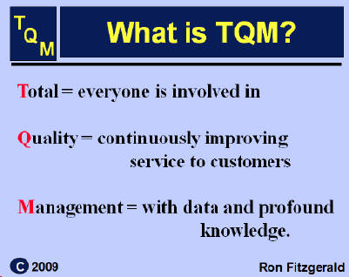
Total quality management (TQM)
interchangeably used with COI
focuses on the totality of systems including services and management
Source: Miller WJ. (1996) A working definition for Total Quality Management (TQM) researchers. J Qual Manage; 1: 149–159

Slide 33
Quality Management Systems
International Standards Organisation - ISO 9000 (www.iso.ch)
JCAHO (http//jcaho.org)
Malcolm Baldrige Award (www.nist.gov)
EFQM Excellence Model (www.efqm.org)
WHO Model

Slide 34

Quality Management is Change Management
takes a lot of time
is evolutionary
is triggered from the outside
must be realized from inside
go step-by-step, don‘t be over ambitious
may give rise to a lot of conflicts and discussions
should be accompanied by an external advisor

Slide 35
Some essentials in modern quality management
Set incentives and goals
Voluntary participation
Do not find faults but areas for improvement
Ownership
Teamwork

